Slide 1
SPL - PS9
Java Sockets

Slide 2
Overview
Introduction to networks
TCP & UDP
Encoding & Decoding
The Client-Server Model

Slide 3
Terminology
Server - A process that provides services to other machines and is accessible over the network.
Client - A process that uses the server’s services.
Host - Any computer that is connected to a network and can communicate with other computers on the same network.
Port - A number 0-65535, that allows to distinguish between services on the same server.
Web server(HTTP) at 80, FTP at 21, …
Socket – Connection's endpoint, used for sending or receiving information.
Socket address is a combination of a port number and an Internet.
1.2.3.4:80
Socket is identified by: (Src IP, Src Port, Dest IP, Dest Port)
Notes:
Worth to mention that ports between 1-1023 are considered “reserved”.

Slide 4
IP Addresses
IP: Internet Protocol
Protocol: Rules of conversation
IP address: A 32-bit number in IPv4 and A 128-bit number in IPv6
132.72.43.254 (IPv4)
2001:abc0:0000:0ea0:0000:0012:fe12:0000 (IPv6)
Restricted IP addresses:
  0.0.0.0 - is reserved for the default network
  255.255.255.255 - is used for broadcasts - intended for all computers on a network
  127.0.0.1 (Loopback) - Used by the host to send a message to itself
DNS service - Maps text names to IP addresses automatically.
www.cs.bgu.ac.il —> 132.72.41.239

Slide 5
Internet protocol
A protocol specifies how data should be
    Packetized (Formatted)
    Addressed
    Transmitted
    Routed
    Received
This functionality is organized into four abstraction layers
  Link Layer – Methods to handle the physical network equipment used to interconnect nodes and servers
  Network Layer - Connects hosts to one another across networks, i.e. common method of routing information packets between networks
  Transport Layer - handles host-to-host communication
  Application Layer - provides process-to-process data exchange

Slide 6



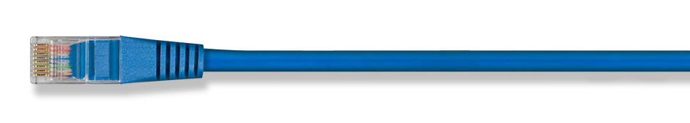
Internet protocol – 4 layers
Application Layer (DNS, FTP, HTTP)
Transport Layer (UDP, TCP)
Internet Layer (IPv4, IPv6)
Link Layer (PPP, ISDN)

Slide 7
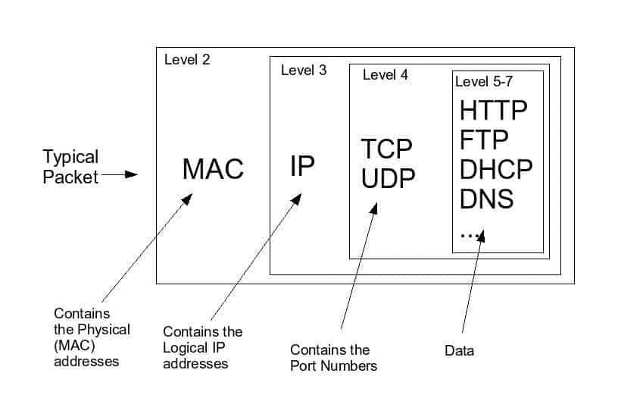
Inside the packet
Notes:
Story time – Lets understand how the internet works. For example, when attempting to order flowers from online store:
You open your computer and search for a WiFi connection to connect to. Your computer finds a local network and connects to it, allowing you to access the internet.
To connect to the local network, your computer uses the Dynamic Host Configuration Protocol (DHCP). DHCP is a network protocol that allows a server to automatically assign an IP address to a device when it connects to the network.
An IP address is a unique numerical label assigned to every device connected to the internet. It is used to identify and locate devices on the network and is necessary for communication between devices.
Once your computer has an IP address, it can communicate with other devices on the network using the Internet Protocol (IP). IP is a network layer protocol that is responsible for routing packets through the internet to their destination.
Next, you open your web browser and type in the URL of the online shop where you want to buy flowers. The URL is a unique address that identifies the location of a specific website on the internet.
To convert the URL into an IP address, your computer uses the Domain Name System (DNS). DNS is a protocol that maps domain names (such as "example.com") to IP addresses.
Your computer sends a request to a DNS server to look up the IP address of the website's server. The DNS server responds with the IP address, which your computer then uses to send a request to the server that hosts the website.
The request is sent using the Hypertext Transfer Protocol (HTTP), which is a set of rules that govern how information is exchanged between computers on the internet. HTTP operates at the application layer of the internet protocol stack, which is the highest layer in the stack and is responsible for providing services to application programs that use the internet.
To send the request, your computer uses the Address Resolution Protocol (ARP) to determine the physical address (such as a MAC address) of the server on the local network. ARP is a protocol that maps IP addresses to physical addresses on a network.
The packet containing the request is sent from your computer to the server using the Transmission Control Protocol (TCP). TCP is a transport layer protocol that ensures that the packet is delivered to its destination reliably and in the correct order. TCP operates at the transport layer of the internet protocol stack, which is responsible for providing end-to-end communication between devices on the internet.
The packet is sent from your computer to the server via a series of interconnected network devices, such as routers and switches, which are responsible for forwarding the packet to its destination. These devices operate at the network layer of the internet protocol stack, which is responsible for routing packets through the internet to their destination.
Once the server receives the request, it responds by sending the HTML code for the website's homepage back to your computer. The response also includes various headers, such as the "Content-Type" header, which indicates the type of content that is being sent, and the "Set-Cookie" header, which is used to send a session cookie to your computer.
The HTML code and headers are packaged into a packet and sent over the internet using the Transmission Control Protocol (TCP). TCP ensures that the packet is delivered to its destination reliably and in the correct order.
The packet is sent from the server to your computer.
Finally, the packet reaches your computer, and your web browser interprets the HTML code and displays the website on your screen.
You decide to log in to the website, so you enter your username and password into the login form. You hit the submit button, which sends a POST request to the server with your login information. The server checks the information against its database to make sure it is correct, and if it is, it sends a session cookie back to your computer.
A cookie is a small piece of data that is stored on your computer and is used to identify you as a unique user. The session cookie allows the server to keep track of your actions on the website as you navigate from one page to another.
Once you are logged in, you browse the online shop's selection of flowers and choose the ones you want to buy. You add them to your virtual shopping cart and proceed to the checkout page.
On the checkout page, you enter your payment information into a form and submit it. The form data is sent to the server using an HTTP POST request, and the server processes the payment and confirms the order.
Finally, the server sends a confirmation page back to your computer, which your web browser displays on your screen. The process is complete, and you have successfully purchased flowers from the local online shop using the internet.
Thank you, ChatGPT.

Slide 8
Overview
Introduction to networks
TCP & UDP
Encoding & Decoding
The Client-Server Model

Slide 9
Datagram Communication - UDP
UDP - user datagram protocol
A connectionless protocol, i.e., send data without prior connection preparation
The failure rate is low, unless the bandwidth is full.
Fast broadcast.
Unreliability, The datagram packet might:
- Not be delivered to the destination host.
- Be delivered in an incorrect order.
- Be delivered twice.
Complicated to program at the application level.

Slide 10
Stream Communication - TCP
TCP - transfer control protocol
Session oriented, Bi-directional, Point to point, Reliable.
Stream oriented protocol means that the data is a sequence of plain bytes
A connection must be established between a client and a server (pair of sockets)

Slide 11
Stream Communication - TCP
Cannot be used for broadcast / multicast transmission.
Might have a bad throughput.
Reliable, Guarantee that:
- All data sent will be received without any error.
- Be delivered in the correct order.
- Errors are automatically corrected.

Slide 12
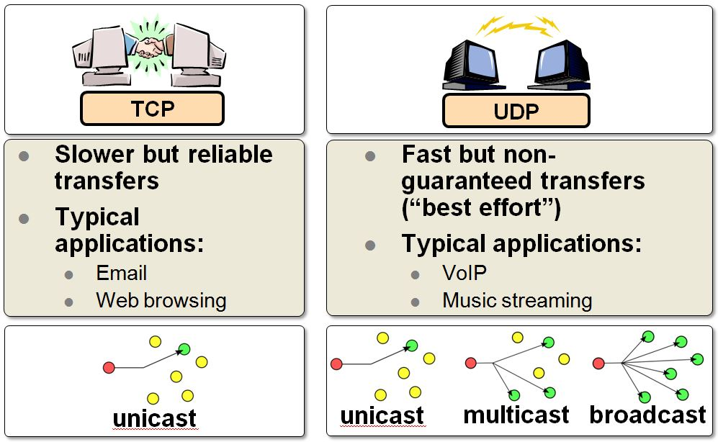
TCP vs UDP
Source: microchip.wikidot

Slide 13
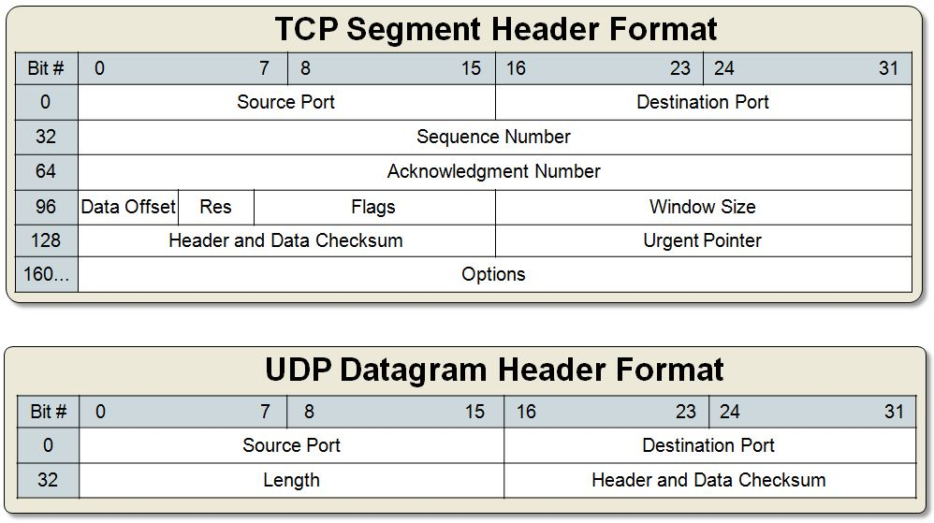
TCP vs UDP
Source: microchip.wikidot

Slide 14
Overview
Introduction to networks
TCP & UDP
Encoding & Decoding
The Client-Server Model

Slide 15
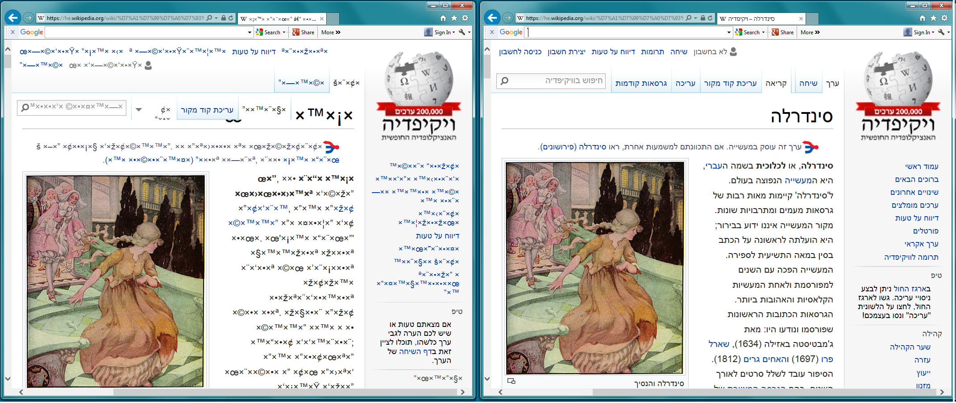
Character Encoding
Bad decoding – When the server and the client don’t agree on the encoding character set
Good decoding ☺

Slide 16
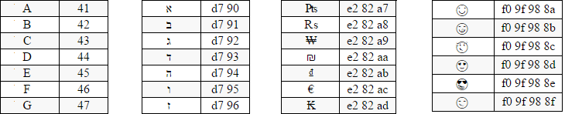
UTF-8 encoding
Basic latin
Hebrew
Currency symbols
Emoticons
UTF-8 Code
UTF-8 Code
UTF-8 Code
UTF-8 Code
Character
Character
Character
Character
Input stream:
41 | 91 | d7 | 90 | d7 | 8a | 98 | 9f | f0 | 42
Decoding:
B
☺
א
ב
A
Source: http://www.utf8-chartable.de

Slide 17
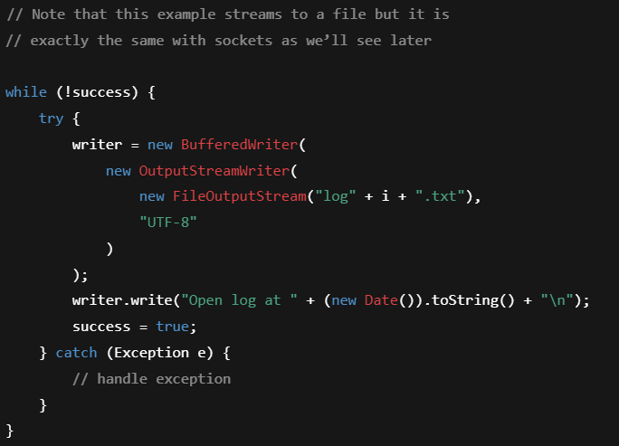
handling text streams in java
Lines and flush
Buffered Writer
Unicode data
Output Stream Writer
Raw byte data
Output Stream
Lines
Buffered Reader
Unicode data
Input Stream Reader
Raw byte data
Input Stream

Slide 18
Character Encoding
Communication requires uniform coding:
  Transferring large objects over streams of bytes requires to encode them.
  Different environment can use different symbols representation.
  Remember, only the char values 0-127 are shared between all encodings
    0–31: Control characters (e.g., NULL, newline, tab)
    32–126: Printable characters (e.g., letters, digits, punctuation)
    127: The DEL (delete) control character - deprecated

Slide 19
Character Encoding
In java
bufferIn = new BufferedReader(new InputStreamReader(clientSocket.getInputStream(),"UTF-8"));
writerOut = new PrintWriter(new OutputStreamWriter(clientSocket.getOutputStream(), "UTF-8"), true);
At the command line:
Use the -D flag (Syntax: -D<name>=<value> set a system property)
C:\> java -Dfile.encoding=US-ASCII LPServer 4500
19

Slide 20
Overview
Introduction to networks
TCP & UDP
Encoding & Decoding
The Client-Server Model

Slide 21
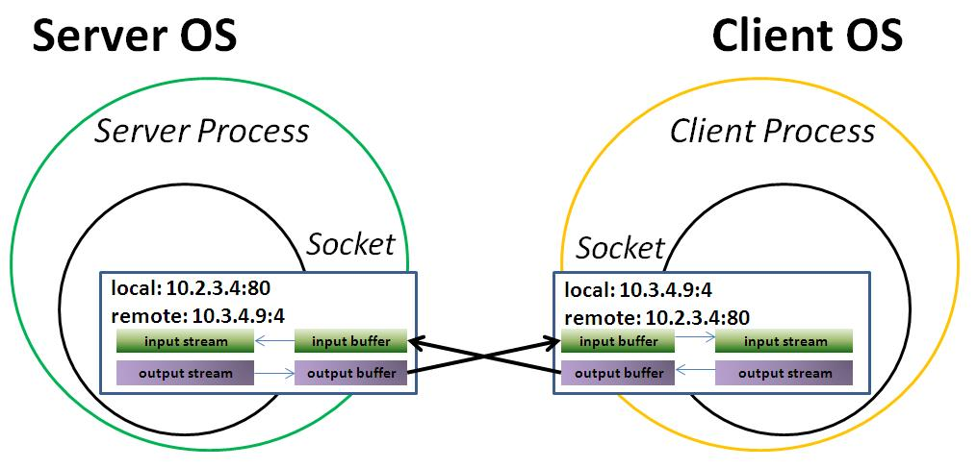
Client-Server architecture
Client-Server model
TCP-connection
The server waits and reacts only to the initiative of the client.
The server creates a separate socket for each client
Servers should be built to maximize availability.

Slide 22
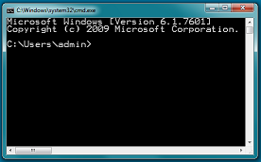

Client-Server example
Line Printer
Server’s monitor
Client’s monitor
Server side
Client side
Socket communication
System out
System out
Keyboard echo
Send the user’s msg
System
in
LPServer
LPClient

Slide 23
LPClient-LPServer code
import java.io.*;
import java.net.*;
public class LPClient {
public static void main(String[] args) {
String serverHostname = args[0]; // Server hostname
int portNumber = Integer.parseInt(args[1]); // Server port number
// Create a socket to connect to the server using try-with-resources
try (Socket socket = new Socket(serverHostname, portNumber);
PrintWriter out = new PrintWriter(socket.getOutputStream(), true);
BufferedReader in = new BufferedReader(new InputStreamReader(System.in))) {
// Read lines from System.in in a loop
String line;
while ((line = in.readLine()) != null) {
// Send the line to the server
out.println(line);
System.out.println("Message sent to server: " + line);
// If the user enters "bye", exit the loop
if (line.equals("bye"))
break;
}
} catch (UnknownHostException e) {
System.err.println("Unknown host: " + serverHostname);
System.exit(1);
} catch (IOException e) {
System.err.println("I/O error: " + e.getMessage());
System.exit(1);
}
}
}
import java.io.*;
import java.net.*;
class LPServer {
public static void main(String[] args) {
int portNumber = Integer.parseInt(args[0]); // Server port number
// Create a server socket to listen for incoming connections
try (ServerSocket serverSocket = new ServerSocket(portNumber);
Socket clientSocket = serverSocket.accept();
BufferedReader in = new BufferedReader(new
InputStreamReader(clientSocket.getInputStream()))) {
// Read and print messages from the client in a loop
String message;
while ((message = in.readLine()) != null) {
// If the client sends "bye", exit the loop
if (message.equals("bye"))
{
System.out.println("Client has requested to end the session.");
break;
}
// Print the message on the line printer
System.out.println("Message from client: " + message);
}
} catch (IOException e) {
System.err.println("I/O error: " + e.getMessage());
System.exit(1);
}
}
}
Client
Server

Slide 24
Client-Server example
Echo Application
Server’s monitor
Client’s monitor
Server side
Client side
Socket communication
System out
System
out
Keyboard echo
Send the user’s msg
System
in
EchoServer
Echo the user’s msg and add
“lol”
EchoClient
24

Slide 25
EchoClient code
public class EchoClient {
public static void main(String[] args) {
// Check the number of command-line arguments
if (args.length != 2) {
System.err.println("Usage: java EchoClient hostname port_number");
System.exit(1);
}
String serverHostname = args[0]; // Server hostname
int portNumber = Integer.parseInt(args[1]); // Server port number
// Create a socket to connect to the server using try-with-resources
try (Socket socket = new Socket(serverHostname, portNumber);
PrintWriter out = new PrintWriter(new OutputStreamWriter(socket.getOutputStream(), "UTF-8"), true);
BufferedReader in = new BufferedReader(new InputStreamReader(socket.getInputStream()));
BufferedReader userIn = new BufferedReader(new InputStreamReader(System.in))) {
String line;
while ((line = userIn.readLine()) != null) {
out.println(line);
System.out.println(in.readLine());
}
} catch (UnknownHostException e) {
System.err.println("Unknown host: " + serverHostname);
System.exit(1);
} catch (IOException e) {
System.err.println("I/O error: " + e.getMessage());
System.exit(1);
}
}
}

Slide 26
EchoServer code
…
public void process() throws IOException {
String msg;
while ((msg = in.readLine()) != null) {
System.out.println("Received \"" + msg + "\" from client");
out.println(msg);
}
}
// Closes the connection
public void close() throws IOException {
in.close();
out.close();
clientSocket.close();
echoServerSocket.close();
}
public static void main(String[] args) throws IOException {
// Get port int
int port = Integer.decode(args[0]).intValue();
EchoServer echoServer = new EchoServer(port);
// Listen on port
try {
echoServer.initialize();
} catch (IOException e) {
System.out.println("Failed to initialize on port " + port);
System.exit(1);
}
// Process messages from client
try {
echoServer.process();
} catch (IOException e) {
System.out.println("Exception in processing");
echoServer.close();
System.exit(1);
}
System.out.println("Client disconnected - bye bye...");
echoServer.close();
}
}
class EchoServer {
private BufferedReader in;
private PrintWriter out;
ServerSocket echoServerSocket;
Socket clientSocket;
int listenPort;
public EchoServer(int port) {
in = null;
out = null;
echoServerSocket = null;
clientSocket = null;
listenPort = port;
}
// Starts listening
public void initialize() throws IOException {
// Listen
echoServerSocket = new ServerSocket(listenPort);
System.out.println("Listening...");
// Accept connection
clientSocket = echoServerSocket.accept();
System.out.println("Accepted connection from client!");
System.out.println(“Client address" + clientSocket.getInetAddress() + ":" + clientSocket.getPort());
// Initialize I/O
in = new BufferedReader(
new InputStreamReader(clientSocket.getInputStream(), "UTF-8"));
out = new PrintWriter(
new OutputStreamWriter(clientSocket.getOutputStream(), "UTF-8"),
true);
System.out.println("I/O initialized");
}
…

Slide 27
Protocol Implementation
The main idea: Implementing the protocol separately provides a more generic design by detaching the communication details from the protocol syntax
interface ServerProtocol {
String processMessage(String msg);
boolean isEnd(String msg);
}
class EchoServer {
private BufferedReader in;
private PrintWriter out;
ServerSocket echoServerSocket;
Socket clientSocket;
int listenPort;
ServerProtocol protocol;
…
public static void main(String[] args) throws IOException {
…
while ((msg = in.readLine()) != null) {
String response = protocol.processMessage(msg);
if (response != null)
out.println(response);
if (protocol.isEnd(msg))
break;
}
…
public class EchoProtocol implements ServerProtocol {
private int counter;
public EchoProtocol() {
counter = 0;
}
public String processMessage(String msg) {
counter++;
System.out.println(counter + ". Received \"" + msg + "\" from client");
if (isEnd(msg))
return new String("Ok, bye bye...");
else
return msg;
}
public boolean isEnd(String msg) {
return msg.equals("bye");
}
}
The previous approach – implemented in EchoServer
while ((message = in.readLine()) != null) {
// If the client sends "bye", exit the loop
if (message.equals("bye"))
{
System.out.println("Client has requested to quit.");
break;
}
}

Slide 28
HTTP - Hypertext Transfer Protocol
HTTP - is an application protocol for distributed, collaborative, hypermedia information systems.
public class HttpClient {
public static void main(String[] args) throws Exception {
String host = args[0];
try (
Socket lp = new Socket(host, 80);
PrintWriter out = new PrintWriter(new OutputStreamWriter(lp.getOutputStream(), "UTF-8"), true);
BufferedReader in = new BufferedReader(new InputStreamReader(lp.getInputStream(), "UTF-8"))) {
out.print("GET / HTTP/1.0\r\n" + "Host: " + host + "\r\n" + "\r\n");
String msg = in.readLine();
while (msg != null) {
System.out.println(msg);
msg = in.readLine();
}
} catch (Exception e) {
System.out.println("Error: " + e);
}
}
}
Client

